Slide 1

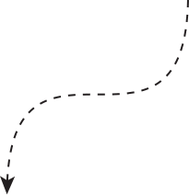
Our Supervisor Professor Dr. Shamim Al Mamun
Online Quiz
Project By
Nasrin Sultana Juthy , Roll:2003
Masuma Rahman Mohoni, Roll:2028
Prienka Rani Barman, Roll: 2031

Slide 2
Overview
Title
The team
Introduction & Overview
Workflow diagram
UI
Code Snippet
Future Work & Conclusion

Slide 3
Introduction
Why Online Quiz System ?
What our system does?
A user friendly web application.
Supports CRUD operations (Create, Read, Update, Delete)
Authentication & Authorization
Automates assessment, reduces workload & errors
Provides real-time feedback & analytics
Shows requirements, modular design & database use
Ensures scalability, usability & security
Applies SDLC, Agile & testing practices
Technologies used: Django(framework), Python, Database(Sqlite), Frontend (Bootstrap, Html, CSS):

Slide 4
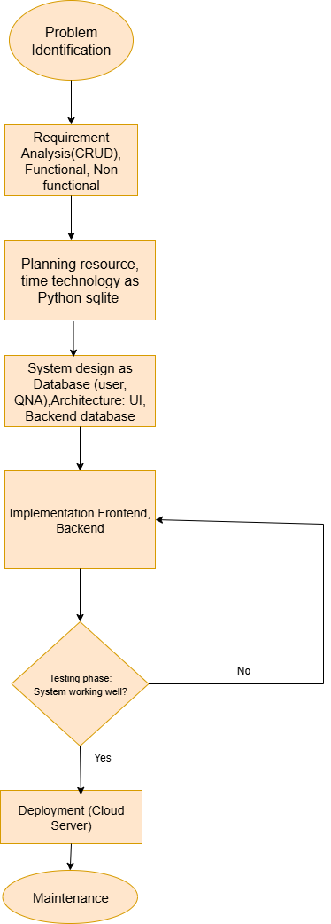
Workflow Diagram:
diagram shows the development process of an online quiz system.First, the problem is identified, followed by requirement analysis (CRUD, functional, non-functional). Then resources, time, and technology (e.g., Python SQLite) are planned. After system design (database, UI, architecture), implementation of frontend and backend is done, tested for correctness, deployed on a cloud server, and finally maintained.

Slide 5
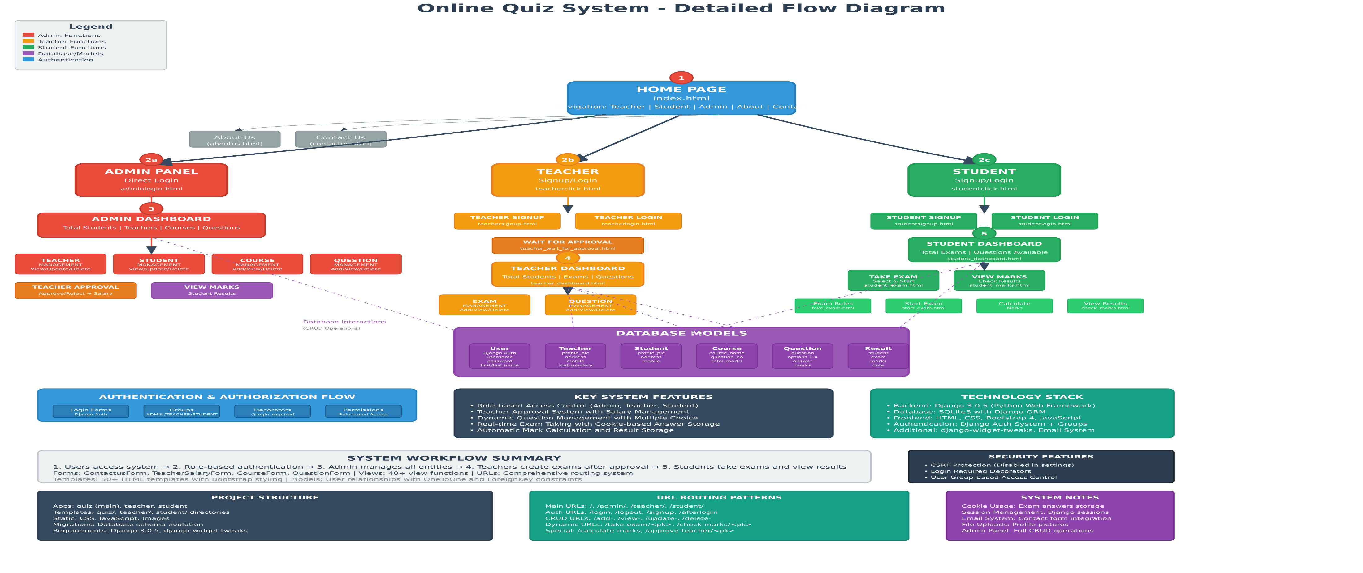
Workflow Diagram:

Slide 6
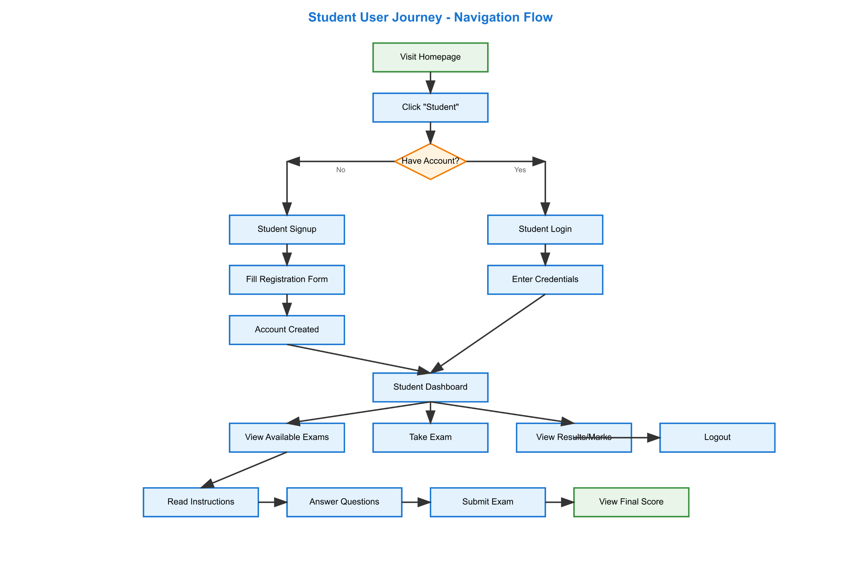
Student Workflow Diagram:

Slide 7
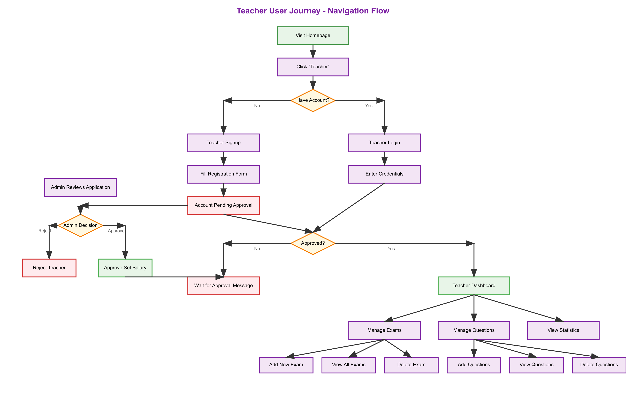
Teacher Workflow Diagram:

Slide 8
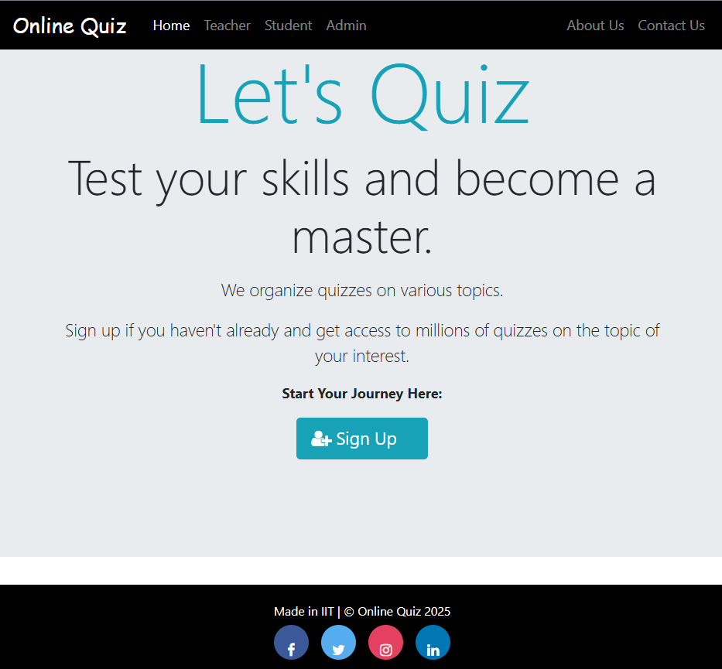
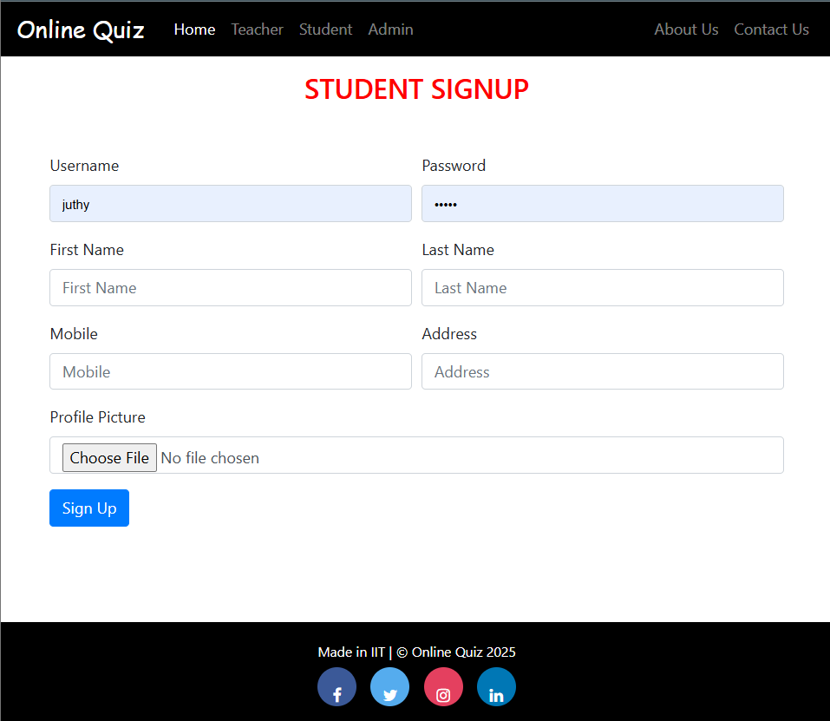
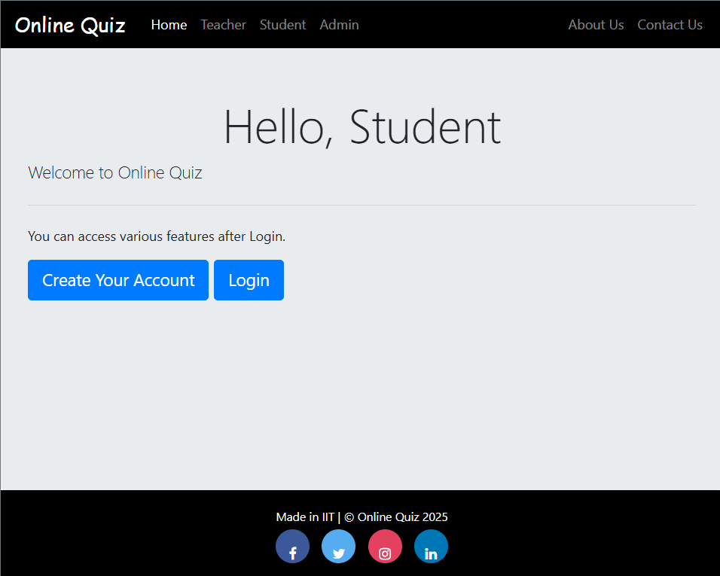

UI(User Interface)(Home & Student)

Slide 9
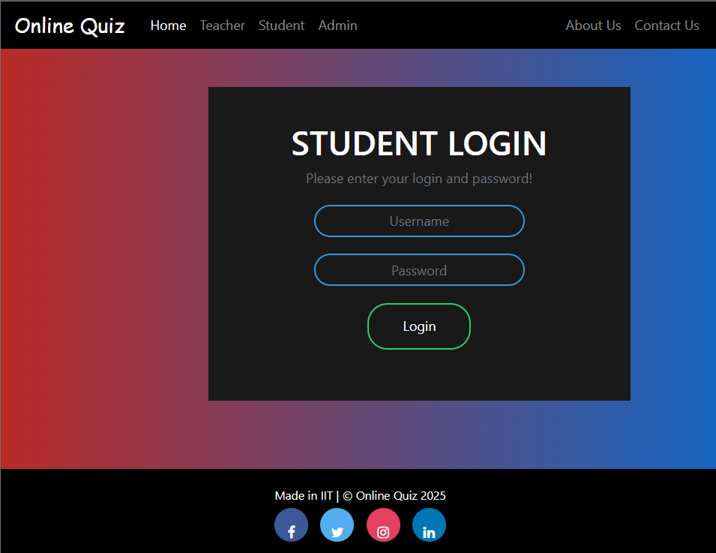
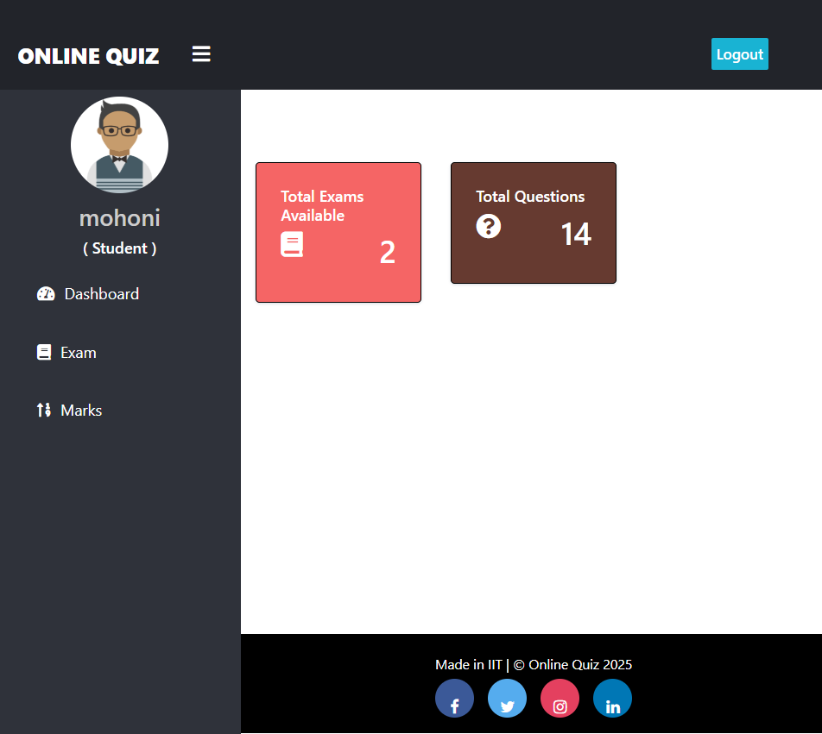
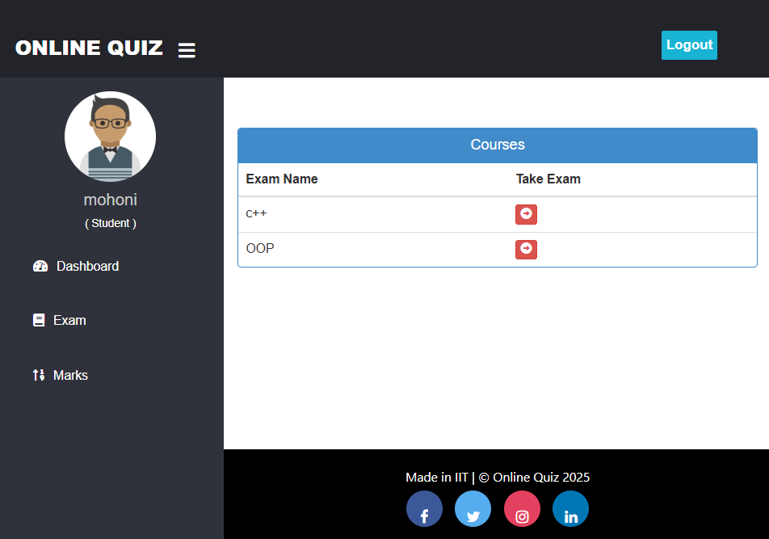
UI(User Interface)

Slide 10

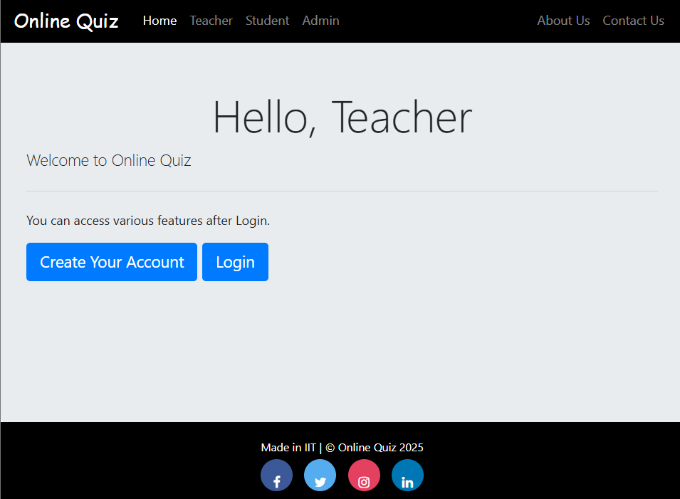
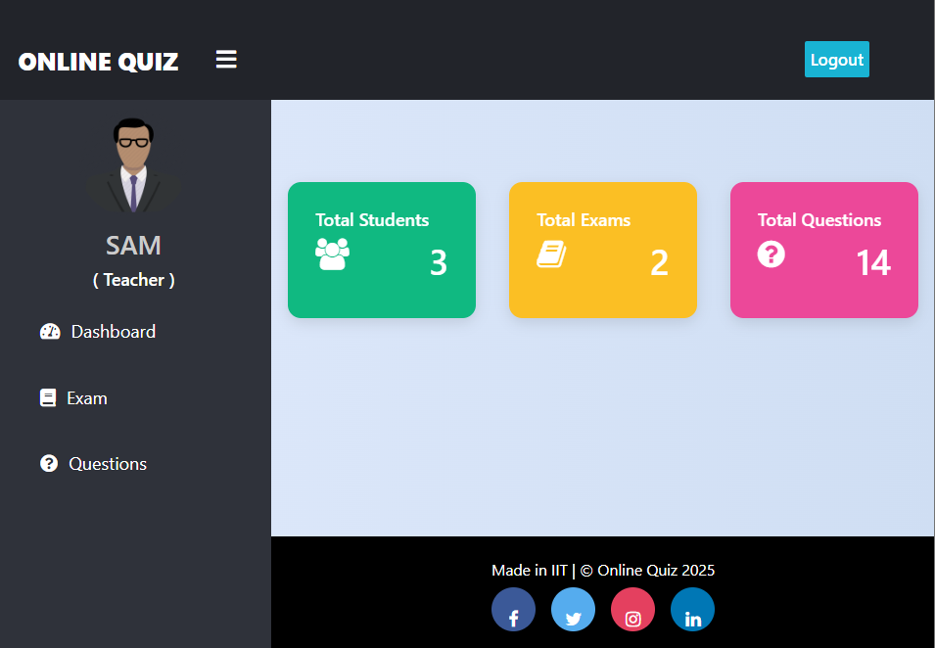
UI(User Interface)

Slide 11
UI(User Interface)

Slide 12
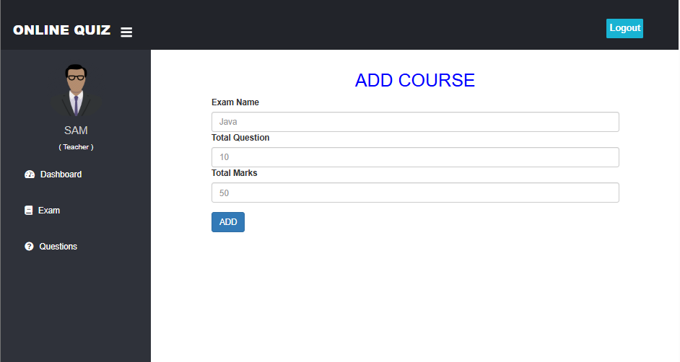
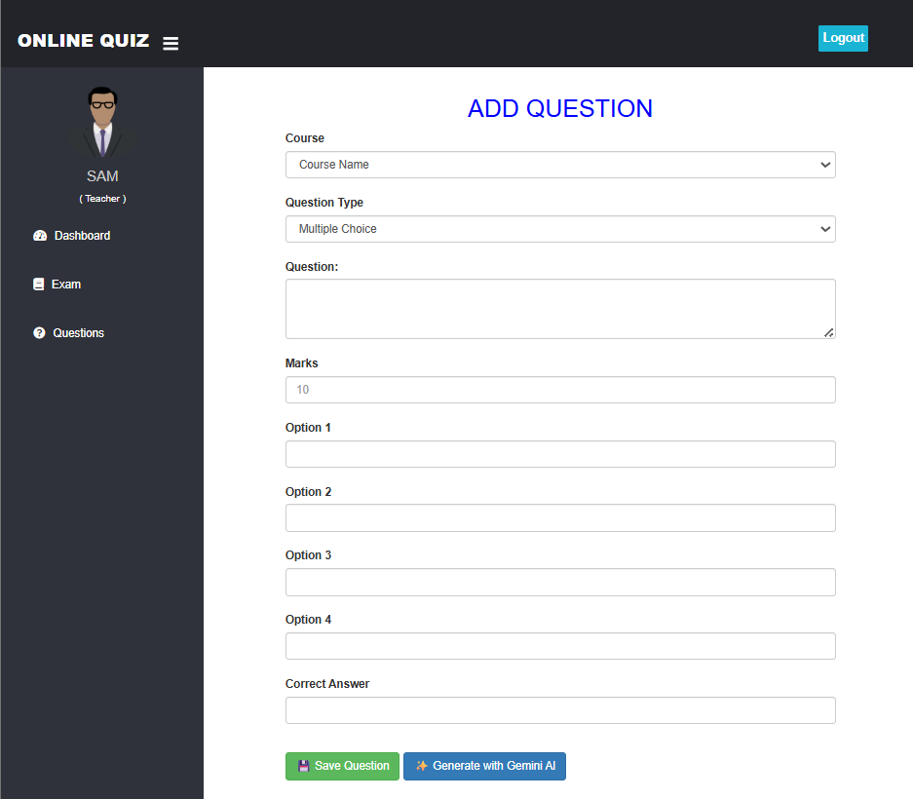
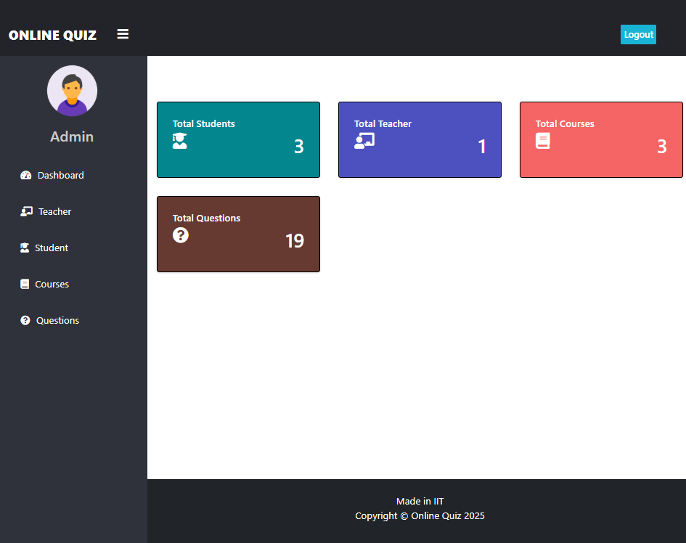
UI(User Interface)

Slide 13
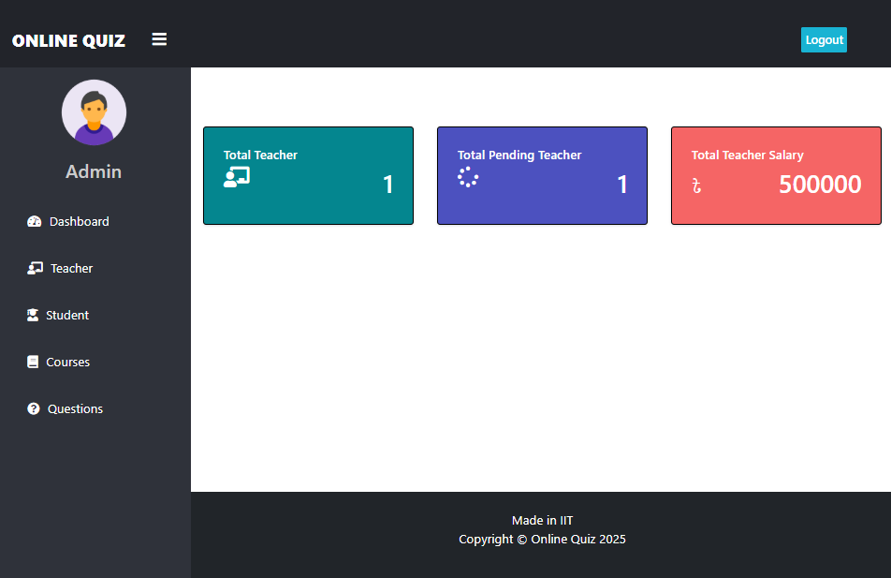
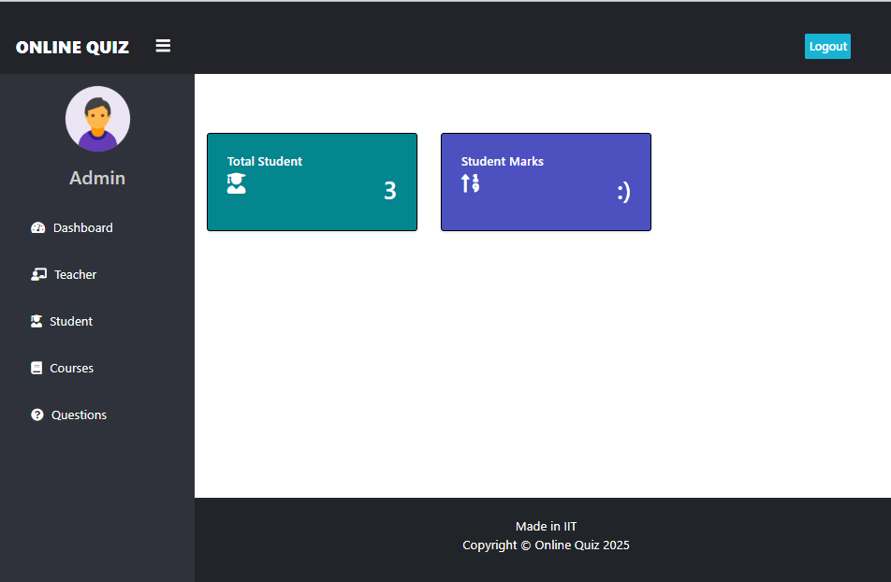
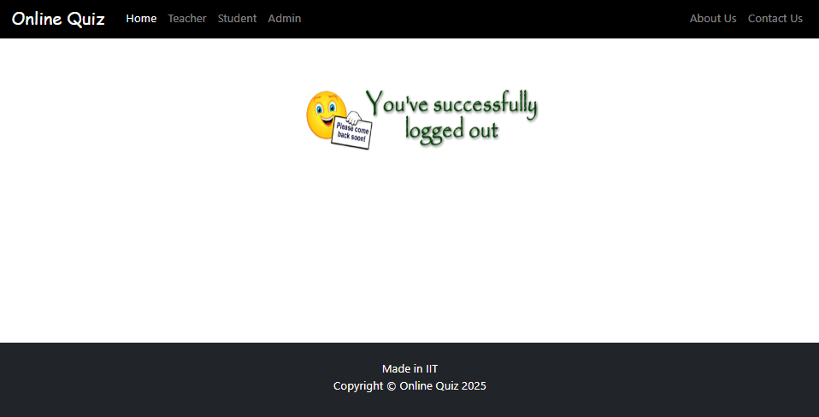
UI(User Interface)

Slide 14
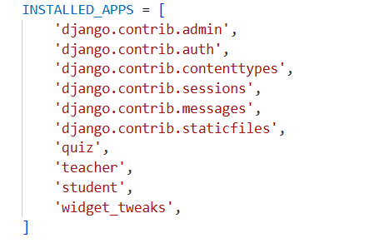
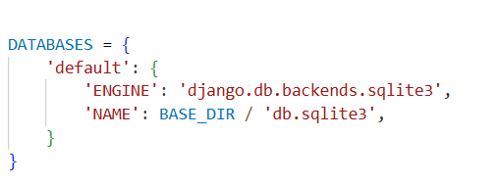
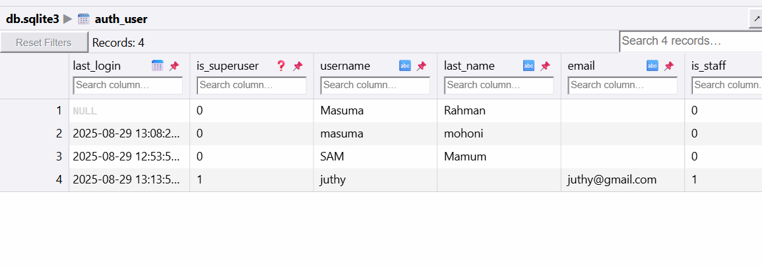
Code Snippet from settings.py:
Dbsqlite3:

Slide 15


Future Work: 1. Adding GenAI to automated fillup
2. Adding more additional options and features
Larger Database System
Mobile Application Integration
Advanced Analytics & Reporting
Conclusion:
1.In conclusion, the Online Quiz System built with Django provides a secure, efficient, and user-friendly platform for online assessments.
2.It enables teachers to create, manage, and evaluate quizzes easily, while students can attempt tests anytime with instant feedback.
3.The system automates quiz management, reducing manual work and errors. Features like authentication, randomization, and result tracking ensure fairness.This project highlights the power of Django in building scalable educational tools.
4.It improves traditional examinations and opens scope for future enhancements.

Slide 16

THANK
YOU!
Any Questions ?

